Slide 1
Introduction to Computer Graphics with WebGL
Ed Angel
Professor Emeritus of Computer Science
Founding Director, Arts, Research, Technology and Science Laboratory
University of New Mexico
Angel and Shreiner: Interactive Computer Graphics 7E © Addison-Wesley 2015

Slide 2
Computer Viewing
Projection
Ed Angel
Professor Emeritus of Computer Science
University of New Mexico
Angel and Shreiner: Interactive Computer Graphics 7E © Addison-Wesley 2015

Slide 3
Objectives
Introduce the mathematics of projection
Add WebGL projection functions in MV.js
Angel and Shreiner: Interactive Computer Graphics 7E © Addison-Wesley 2015

Slide 4
Projections and Normalization
The default projection in the eye (camera) frame is orthogonal
For points within the default view volume
Most graphics systems use view normalization
  All other views are converted to the default view by transformations that determine the projection matrix
  Allows use of the same pipeline for all views
x_{p} = x
y_{p} = y
z_{p} = 0
Angel and Shreiner: Interactive Computer Graphics 7E © Addison-Wesley 2015

Slide 5
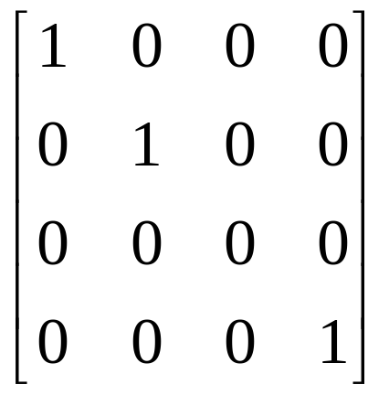
Homogeneous Coordinate Representation
default orthographic projection
x_{p} = x
y_{p} = y
z_{p} = 0
w_{p} = 1
p_{p} = Mp
M =
In practice, we can let M = I and set
the z term to zero later
Angel and Shreiner: Interactive Computer Graphics 7E © Addison-Wesley 2015

Slide 6
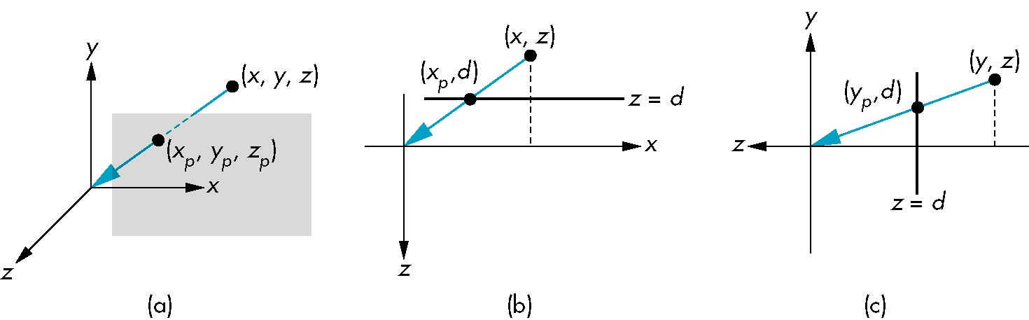
Simple Perspective
Center of projection at the origin
Projection plane z = d, d < 0
Angel and Shreiner: Interactive Computer Graphics 7E © Addison-Wesley 2015

Slide 7
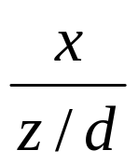
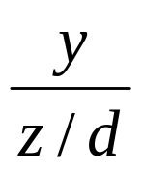
Perspective Equations
Consider top and side views
x_{p} =
y_{p} =
z_{p} = d
Angel and Shreiner: Interactive Computer Graphics 7E © Addison-Wesley 2015

Slide 8
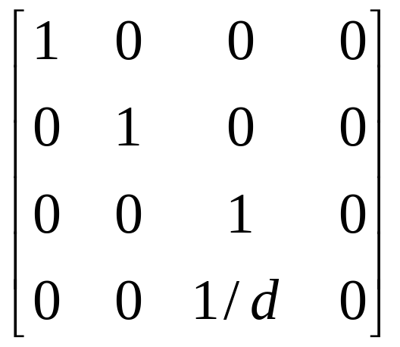
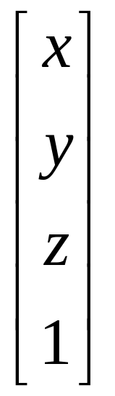
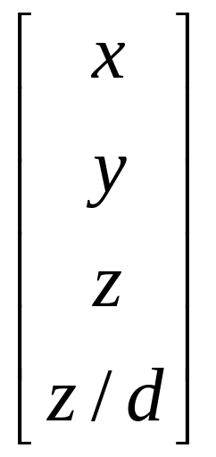
Homogeneous Coordinate Form
consider q = Mp where
M =
q =
⇒ p =
Angel and Shreiner: Interactive Computer Graphics 7E © Addison-Wesley 2015

Slide 9
Perspective Division
However w ≠ 1, so we must divide by w to return from homogeneous coordinates
This perspective division yields
the desired perspective equations
We will consider the corresponding clipping volume with mat.h functions that are equivalent to deprecated OpenGL functions
x_{p} =
y_{p} =
z_{p} = d
Angel and Shreiner: Interactive Computer Graphics 7E © Addison-Wesley 2015

Slide 10
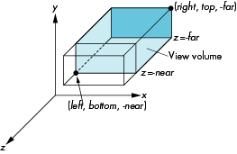
WebGL Orthogonal Viewing
ortho(left,right,bottom,top,near,far)
near and far measured from camera
Angel and Shreiner: Interactive Computer Graphics 7E © Addison-Wesley 2015

Slide 11
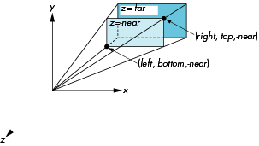
WebGL Perspective
frustum(left,right,bottom,top,near,far)
Angel and Shreiner: Interactive Computer Graphics 7E © Addison-Wesley 2015

Slide 12
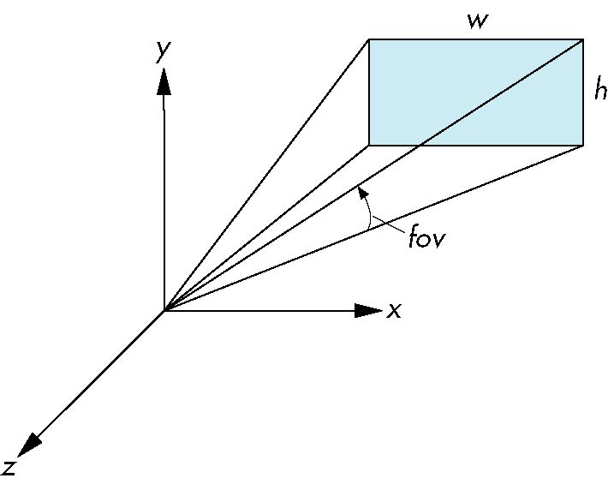
Using Field of View
With frustum it is often difficult to get the desired view
perpective(fovy, aspect, near, far) often provides a better interface
front plane
aspect = w/h
Angel and Shreiner: Interactive Computer Graphics 7E © Addison-Wesley 2015

Slide 13
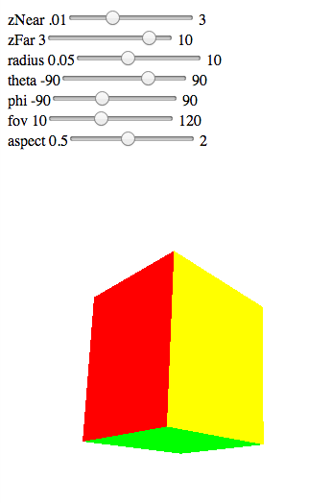
Computing Matrices
Compute in JS file, send to vertex shader with gl.uniformMatrix4fv
Dynamic: update in render() or shader
Angel and Shreiner: Interactive Computer Graphics 7E © Addison-Wesley 2015

Slide 14
persepctive2.js
var render = function(){
gl.clear( gl.COLOR_BUFFER_BIT | gl.DEPTH_BUFFER_BIT);
eye = vec3(radius*Math.sin(theta)*Math.cos(phi),
radius*Math.sin(theta)*Math.sin(phi), radius*Math.cos(theta));
modelViewMatrix = lookAt(eye, at , up);
projectionMatrix = perspective(fovy, aspect, near, far);
gl.uniformMatrix4fv( modelViewMatrixLoc, false,
flatten(modelViewMatrix) );
gl.uniformMatrix4fv( projectionMatrixLoc, false,
flatten(projectionMatrix) );
gl.drawArrays( gl.TRIANGLES, 0, NumVertices );
requestAnimFrame(render);
}
Angel and Shreiner: Interactive Computer Graphics 7E © Addison-Wesley 2015

Slide 15
vertex shader
attribute vec4 vPosition;
attribute vec4 vColor;
varying vec4 fColor;
uniform mat4 modelViewMatrix;
uniform mat4 projectionMatrix;
void main() {
gl_Position = projectionMatrix*modelViewMatrix*vPosition;
fColor = vColor;
}
Angel and Shreiner: Interactive Computer Graphics 7E © Addison-Wesley 2015

